Slide 1
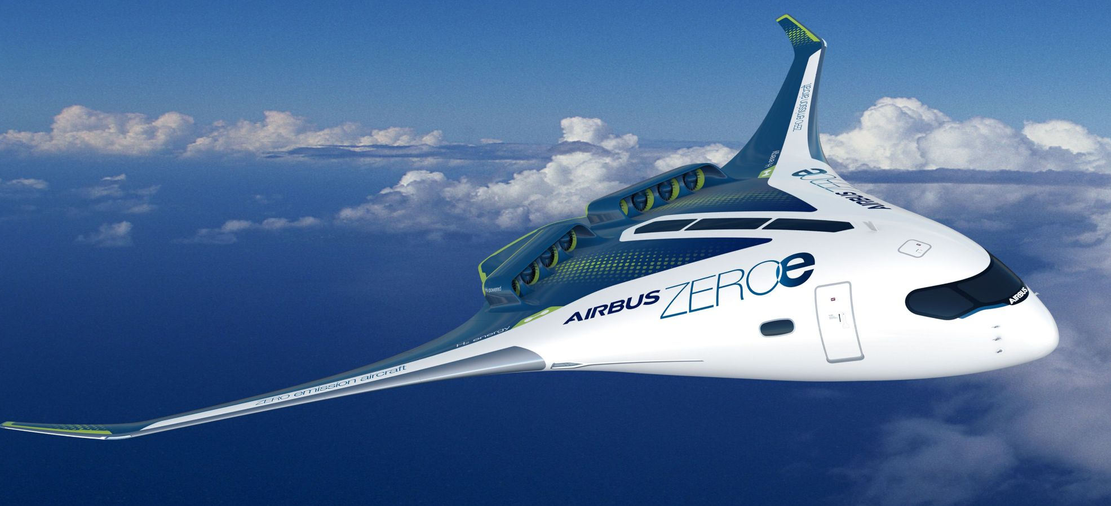
KONNEX
An Application Assistant

Slide 3
What
You must have little idea from the previous slides, something that’s related to assist the user but through complex application. So let's dive a little deeper.
IS
KONNEX is supposed to act like an guardian who’s overlooking your activity sitting on top of the application/website and helps you in making your experience of using the application better.
KONNEX ?
Sounds cool. Really? Even if YES, do we really need this in day-to-day life? Let’s explore this in “Why KONNEX?” section.

Slide 4
Why KONNEX ?
If you have applied for DL(Driving License)/Passport from the official website, there's a small probability that you were stuck at a point completely clueless of what to fill in this section. This takes place due to lack of user’s awareness or unclear design of website.
Here in above example, we can’t have direct communication with team maintaining the application, so user can provide an innovative solution that can also report bug directly which can be processed to tackle general users issue easily.
Moreover we can’t expect team maintaining the application to change website design overnight. So what we propose is that someone with a better understanding of such platform can create an innovative solution or application (we named KONNEX ) that can ease the user experience.

Slide 5
Why KONNEX ?
Similarly in our professional life as well, we come across a lot of such applications/websites that are not easy to use, sometimes it’s quite alien to most of people, so people are unaware with noone to help. In few cases, it’s the complex design that also keeps people struggling while all the time development team being unaware due to communication gap.
So, KONNEX can be an impactful solution which is the need of hour.
Let’s dig, digest and design...

Slide 6
What do we expect ?
Application Navigation (searchable tool tip)
Support chatbot / collaboration charbot
Application Improvement & co-creation
Bug reporting window
Collective Announcements
Easily customized to adapt throughout the application.
Measure application usage, performance
Build a customizable application with admin console that provides extended widget for :

Slide 7
DONE with MVP ? Try for Brownie points
We first recommend ensure the MVP is working well end to end then only go for Brownie Points.
1
Think outside the box for one such feature, that makes your product outclass others.
2
Come up with more user interactive features that focuses on either ease of user experience or makes it fun filled.
3
Example : Enhanced security, support for differently abled people, Gamification features, AI/ML Capabilities etc.
4

Slide 8
Thank You!
© Copyright Airbus (2021) | KONNEX
This document and all information contained herein is the sole property of Airbus. No intellectual property rights are granted by the delivery of this document or the disclosure of its content. This document shall not be reproduced or disclosed to a third party without the expressed written consent of Airbus. This document and its content shall not be used for any purpose other than that for which it is supplied.
Airbus, its logo and product names are registered trademarks.

